Slide 1
NON-Verbal Communication
Differences Between Nationalities

Slide 2
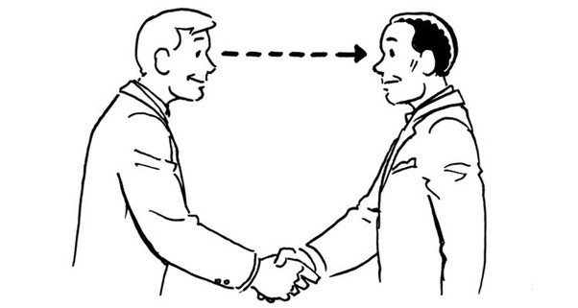
Eye Contact
United States
Western Europe
Middle East
Asian, Latin, America, and Africa

Slide 3
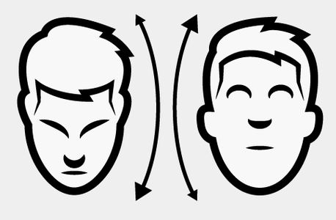
Body Movement and Posture
America
Bulgarians and Greeks
Others such as Cambodia, Japan, China, etc.

Slide 4

Body Movement and Posture
America
Asia, the Middle East, and Europe

Slide 5

Gesture
Middle East
Arabic
Others

Slide 6

Gesture
United State
Cambodia
Philippines

Slide 7

Greeting With Handshake
Western
Far East
In parts of Northern European
In parts of Southern Europe
Central and South America
Turkey
African Countries
Men in Islamic countries

Slide 8
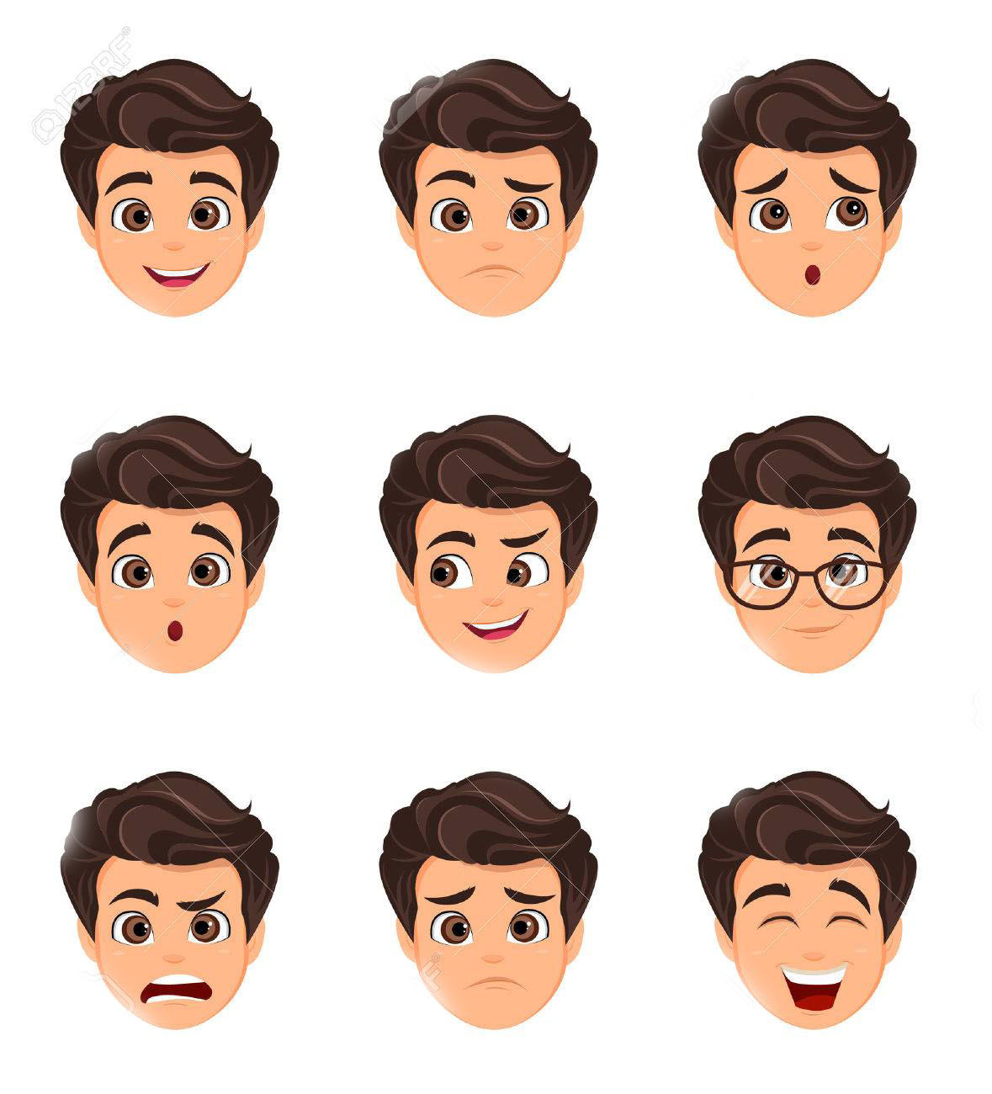
Facial Expressions
United States
Asian
Russia
Scandinavians

Slide 9
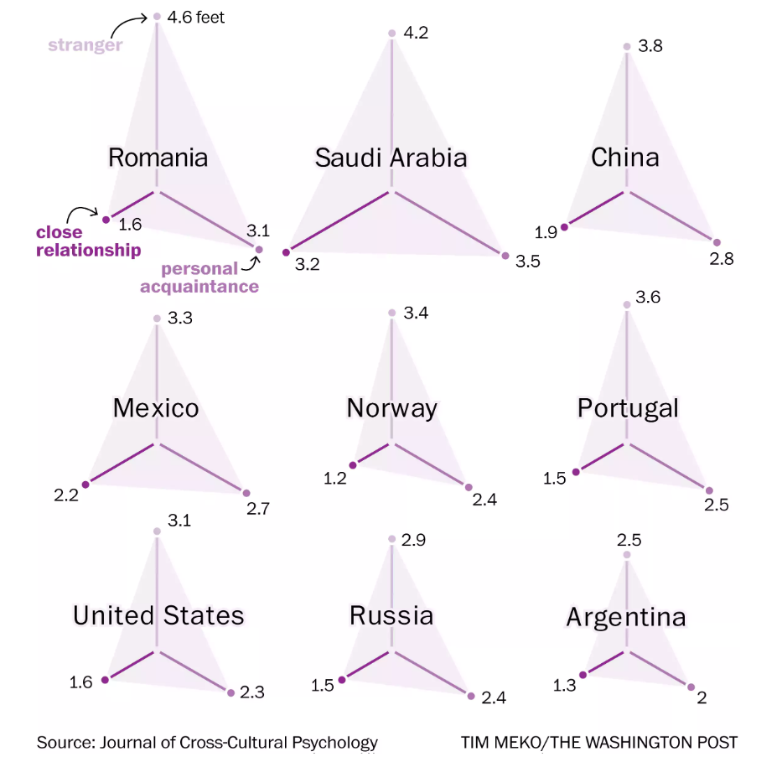
Physical Space
Romania
Saudi Arabia
China
Mexico
Norway
Portugal
United States
Russia
Argentina

Slide 10


Slide 11
THE
END
THANKS YOU FOR PAYING ATTEND TO OUR PRESENTATION.

